Slide 1
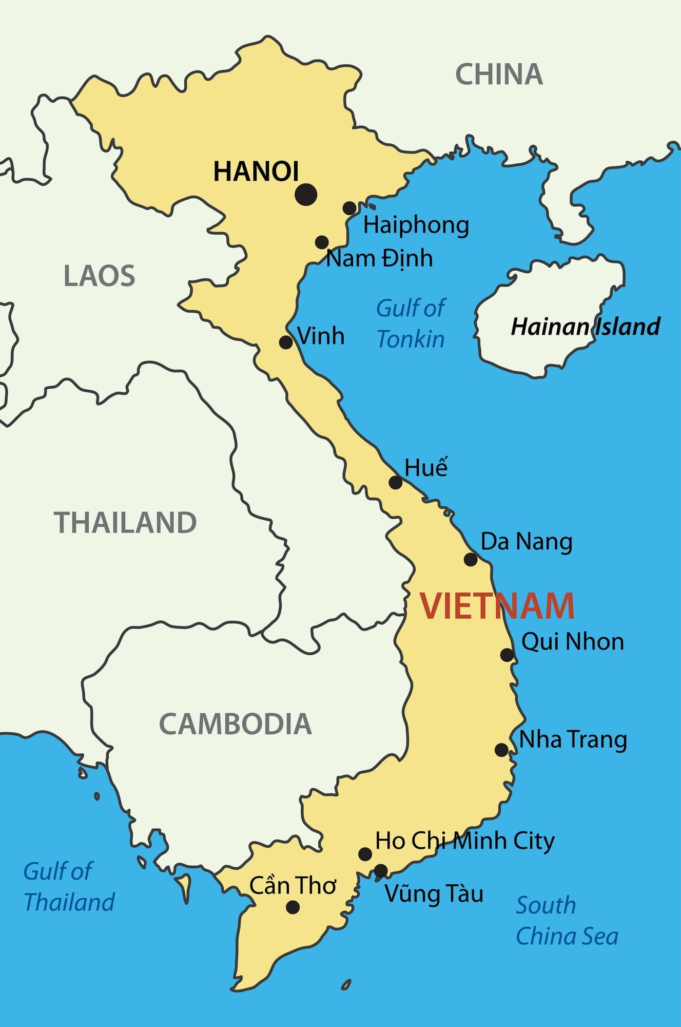
The Vietnam War
The first war of the 20th century lost by America
An ongoing trauma – even today
60 000 Deaths (US) / 3 000 000 Deaths (Vietnam)
First war with active media involvement
Notes:
Welcome
<Click>
The first war of the 20th century lost by America
<Click>
Even today – ongoing drama – More: Later
<Click>
60 000 = sixty thousand
3 000 000 = three milion
About 2 000 000 severe injuries because of highly-toxic chemicals
<Click>
First war with active media involvement
<Click>
But let’s start at the beginning
<Click>
+ Guerilla

Slide 2
The Vietnam War
The first war of the 20th century lost by America
An ongoing trauma – even today
60 000 Deaths (US) / 3 000 000 Deaths (Vietnam)
First war with active media involvement

Slide 3
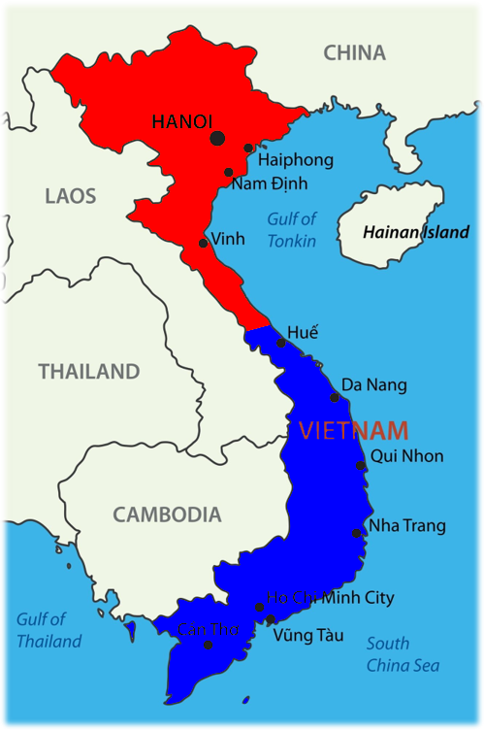
Proxy War - Cold-War
North Vietnam - Ho Chi Minh
Supported by the Soviet Union
South Vietnam - Ngô Đình Diệm
Supported by the USA
Guerrilla warfare
USA used „Agent Orange“
1973: Parisian Ceasefire
1975: End of the war
Notes:
The Vietnamese war was a Proxy War for the cold war
North Vietnam - Ho Chi Minh
Later Supported by the Soviet Union
South Vietnam - Ngô Đình Diệm
Later Supported by the USA
Civil War in Vietnam
After Military conflicts with the stat. usa in south Vietnam, USA starts bombing north
Slowly, not wanting to risk an atomar war against china or soviet union
This did’t really work, so the fight continued.
The north-Vietnamese soldiers were guerrilla soldiers.
That means, they hid themselves in the jungle and they looked like the civil population
To circumvent this strategy, the us used the so-called “Agent Orage” (consists of two herbicides and TCDD, a strong organic poison)
This deforests the rainforest, what makes it difficult for the north-Vietnamese soldiers to hide
So, they hid in underground bunkers,
This guerilla-style had also massive implications on the US-Soldiers moral
Let’s skip forward in time a little: 1973 was the Parisian Ceasefire singed, wherein the demands of north Vietnam were satisfied.
Slowly, the north conquered the south
After this, the war was won by the north-Vietnamese in 1975
And that’s it

Slide 4
Sources
Mirko Drotschmann et. al.: https://cjstevenson.com/projects/u/bv8GS
Anonym <Nilfanion> et. al: https://cjstevenson.com/projects/u/RPIwl
CIA: https://cjstevenson.com/projects/u/7WZLh
Prof. Dr. Rolf Steininger / bpb: https://cjstevenson.com/projects/u/WWyKv
Fig. 1: Fredrik Gronkvist: https://cjstevenson.com/projects/u/NJ6L8
Fig. 2: Fredrik Gronkvist (Fig. 1), edited

